Slide 1


Drug Test – Drug Group Prediction
Nano Project

Slide 2
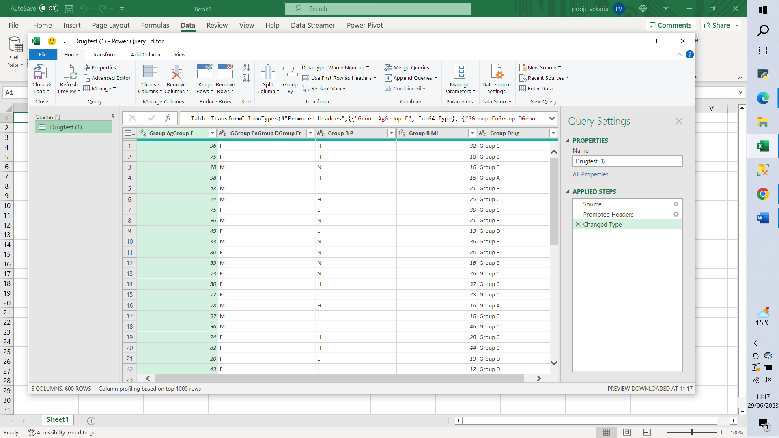
1. Clean/Transform Data in Excel – Ensure no errors, blanks, and correct column headings are used and save excel file as a csv file:

Slide 3
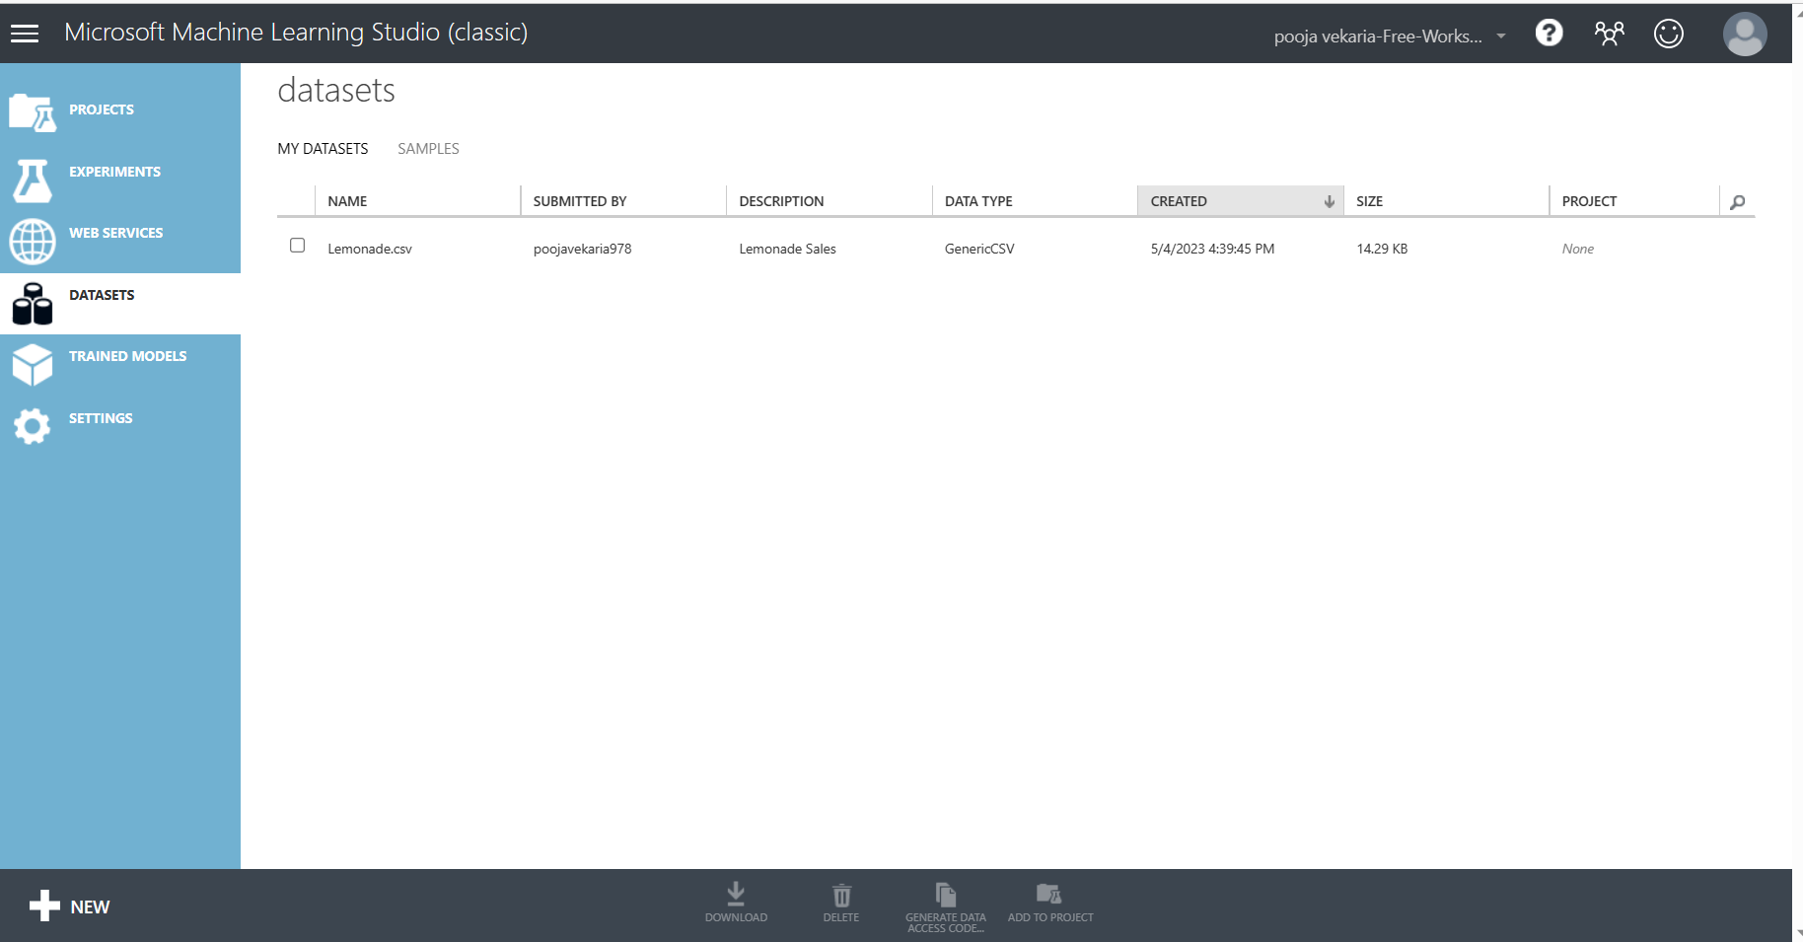
2. Upload Drug Test.csv File to Microsoft machine learning studio:

Slide 4
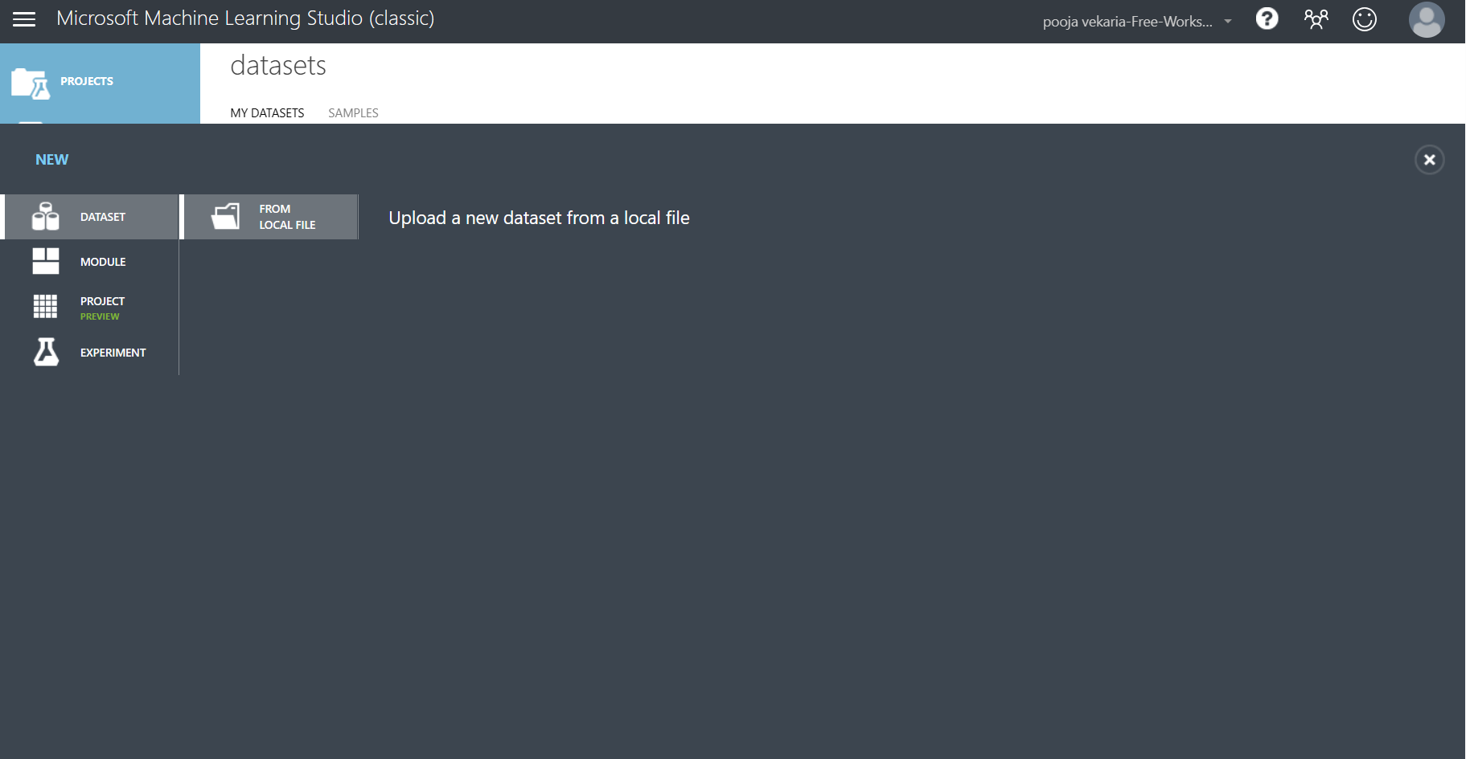
3. Click on from local file:

Slide 5
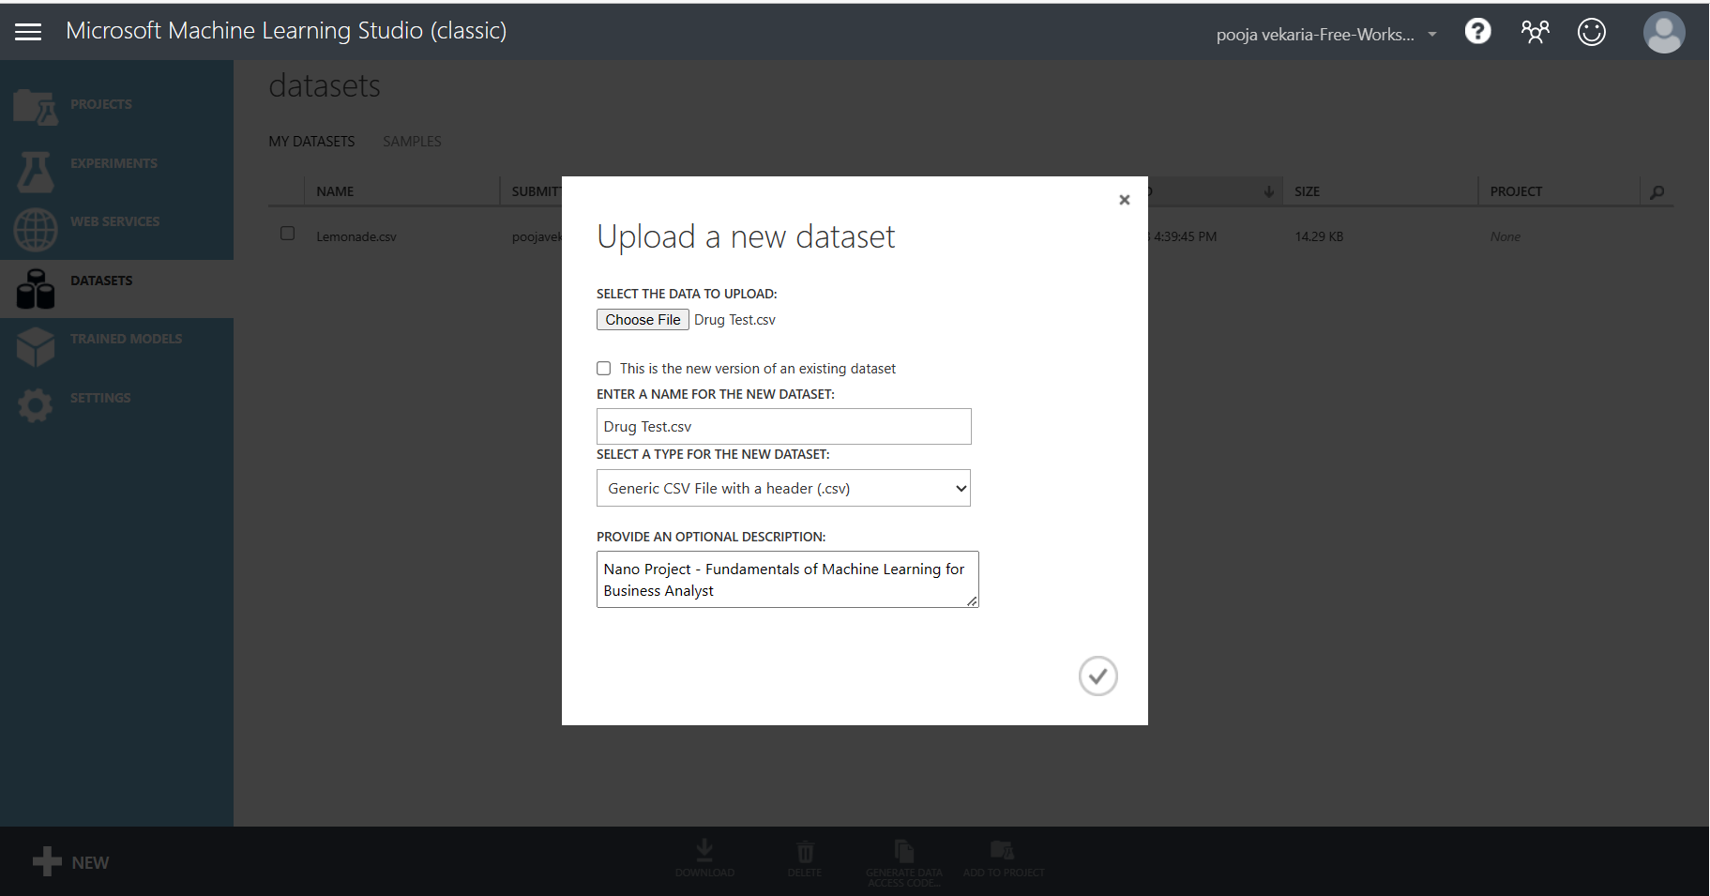
4. Choose file; Drug Test.csv file from pathway location where file is saved and click on tick to upload file to Microsoft Machine Learning Studio.

Slide 6
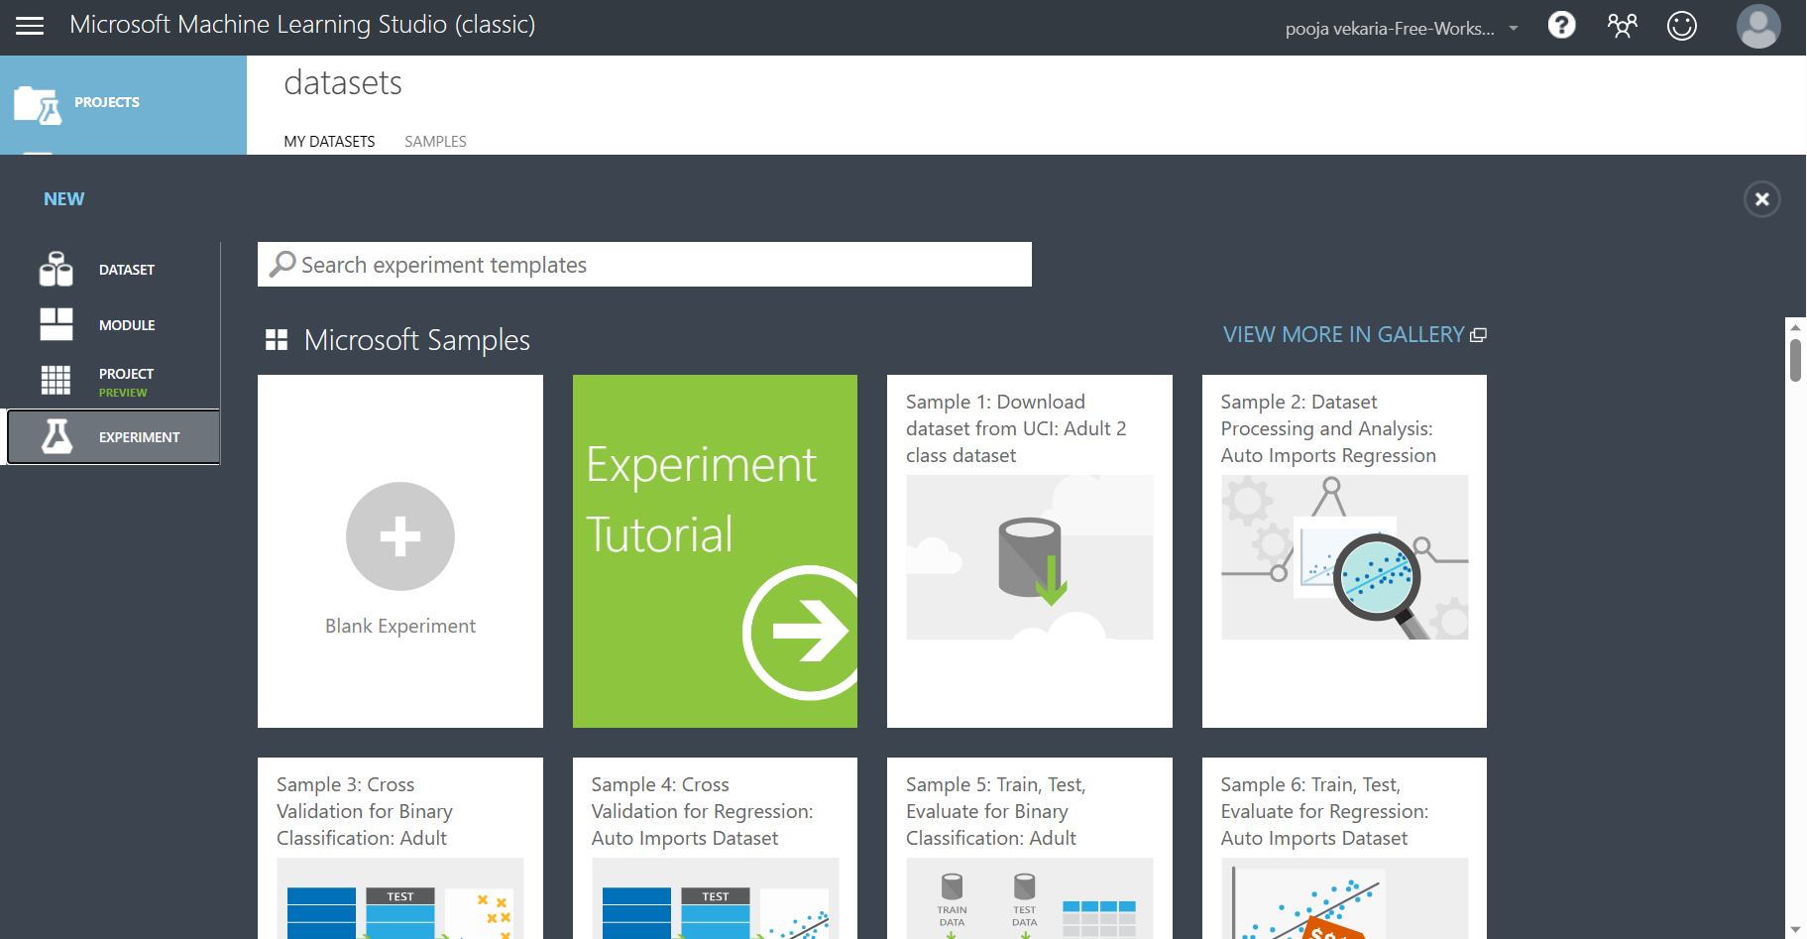
5. Click on New and then Blank Experiment to start a new experiment.

Slide 7
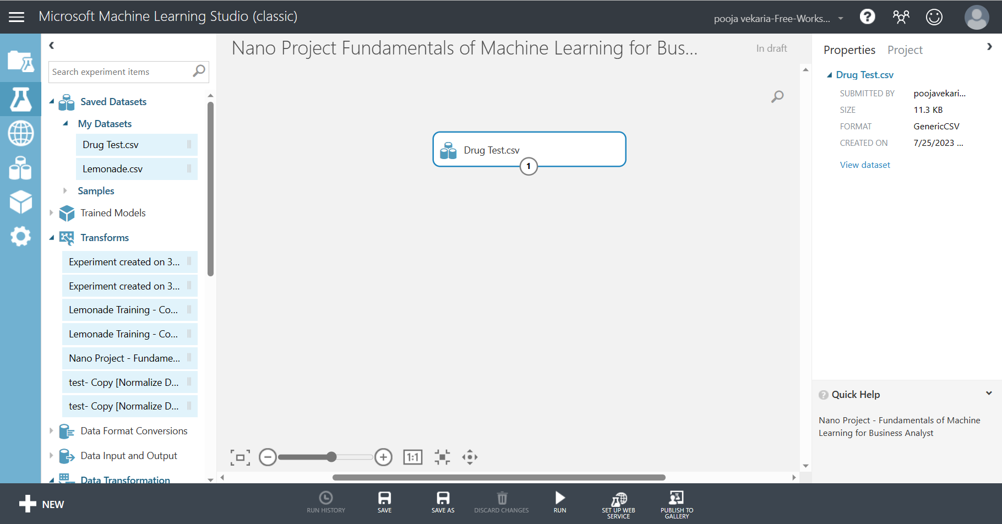
6. Once the experiment page has loaded give the experiment a title and drag and drop the Drug Test.csv file on to the main page from the left side bar.

Slide 8
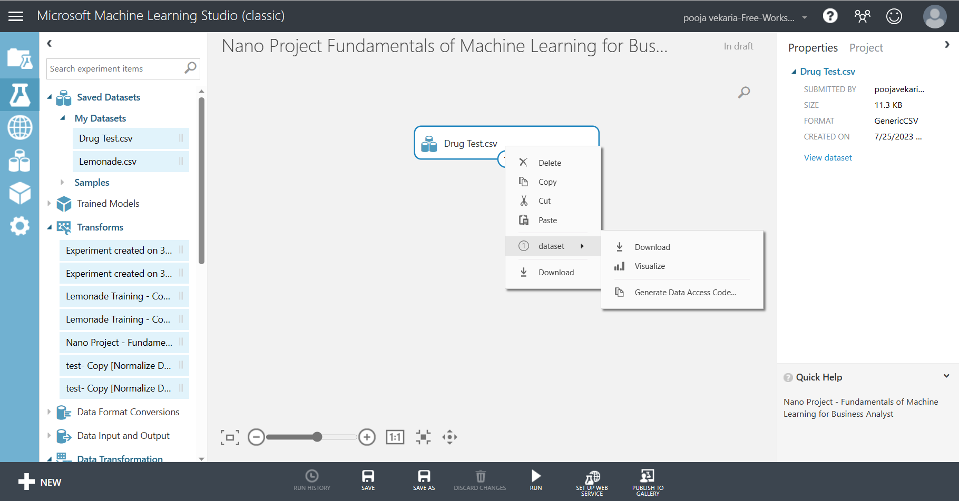
7. Ensure data has loading appropriately to check the data right click on the Drug Test Module and scroll to dataset and then select visualize – this will give you a preview of the data loaded.

Slide 9
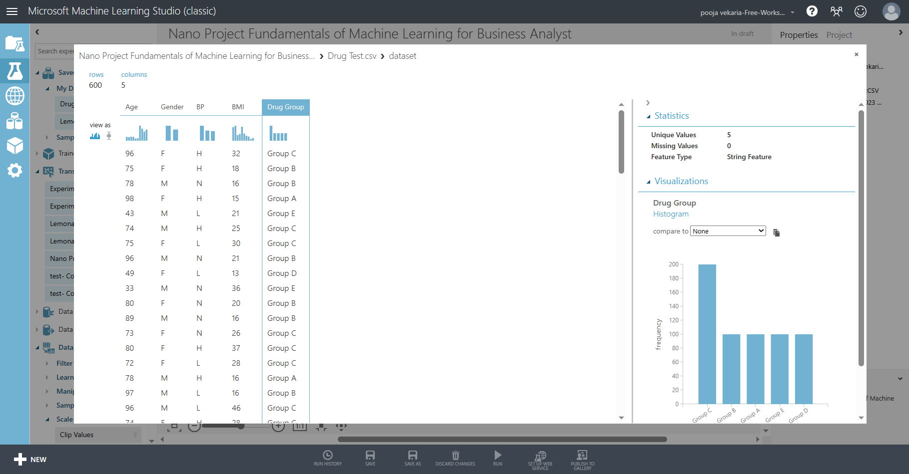
8. Check the data types are correct and columns are correctly labelled and no errors/blanks in the data.

Slide 10
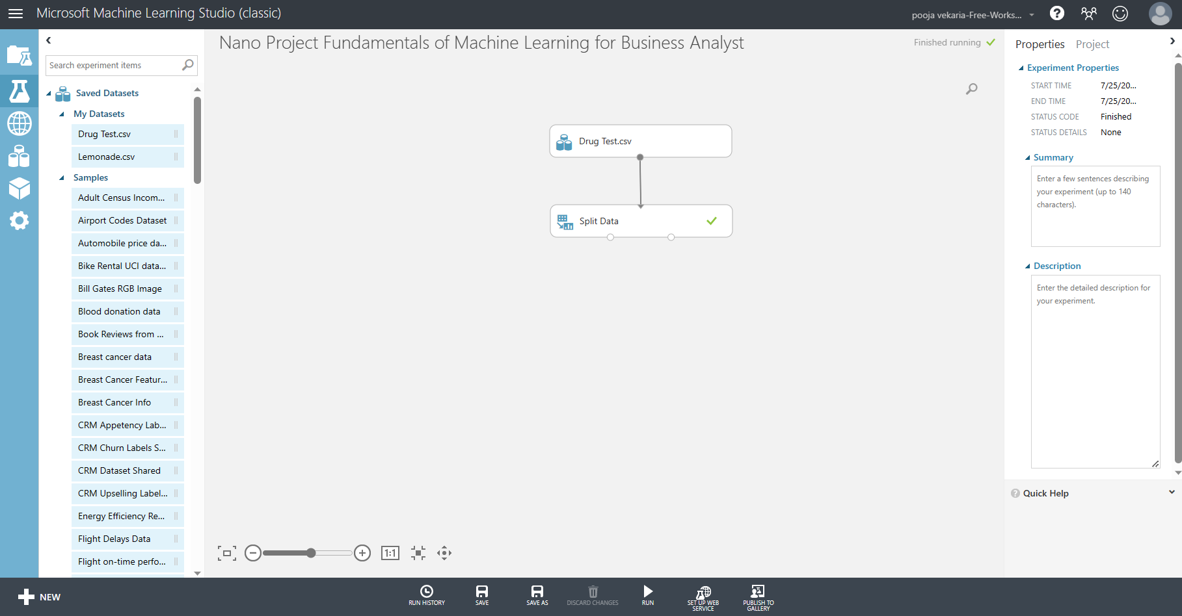
9. On the search bar search for spilt data and drop tile underneath the normalize data and connect the two tiles, change the properties to state the following: splitting mode as spilt rows, fraction of rows in the first output dataset as 0.7, click the randomized split, random seed as 0, and stratified split as false and click run. This will divide the data into two data sets and help evaluate the performance of the model on unseen data.

Slide 11
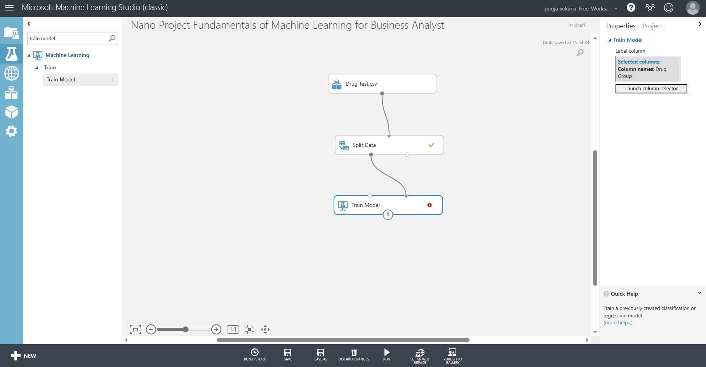
10. On the search bar search for train model and drag and drop the tile underneath the split data tile and connect, launch the column selector and drag drug group from available column to selected column and click the tick.

Slide 12
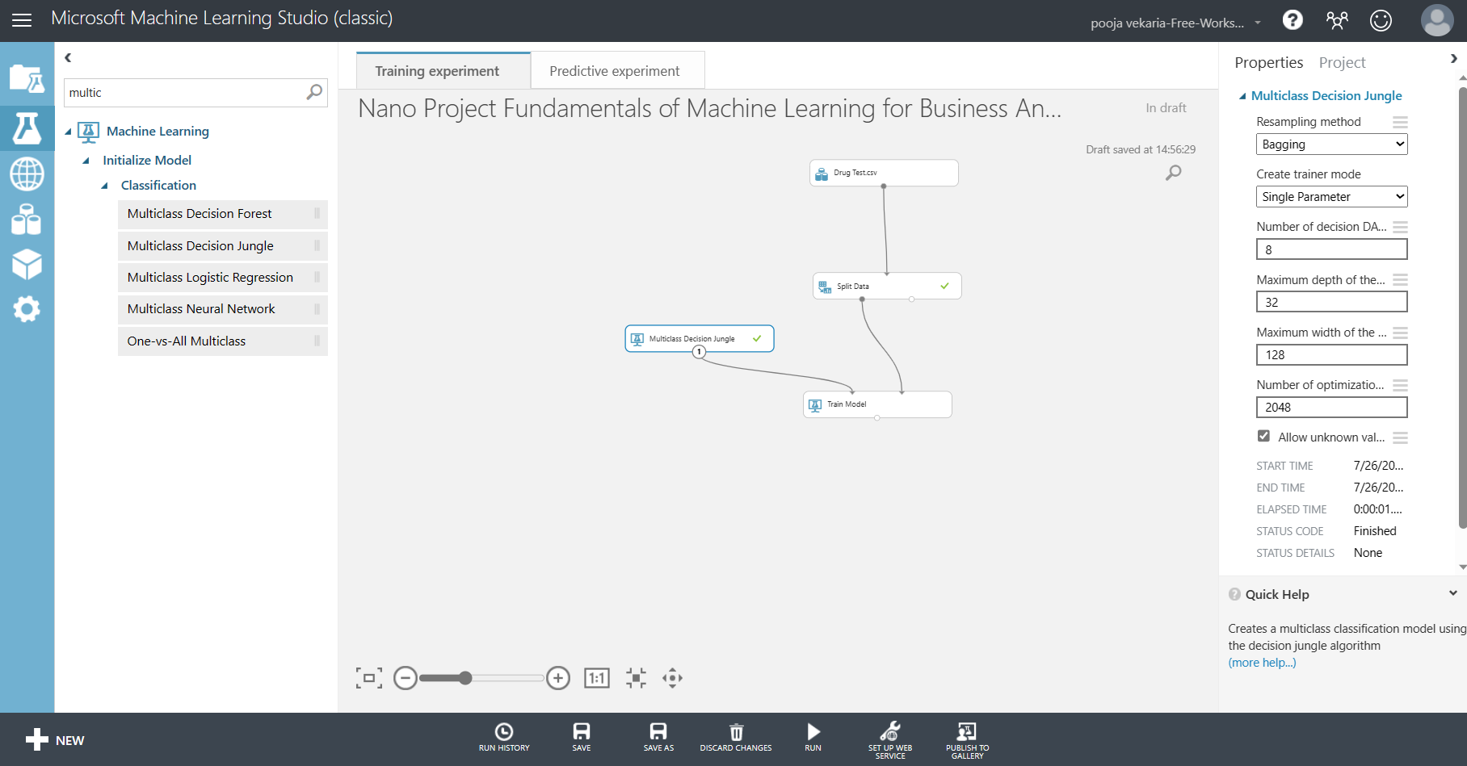
11. On the search bar search for multi-class decision jungle and drag and drop tile next to the train model tile and connect tiles, in the properties the following should be applied for sampling method: Bagging, Create trainer mode: Single Parameter, Number of decision DAGs:8, Maximum depth of the decision DAGs:32, Maximum width of the decision DAGs: 128, Number of optimisation steps per decision DAG layer: 2048, allow unknown values for categorical features.

Slide 13
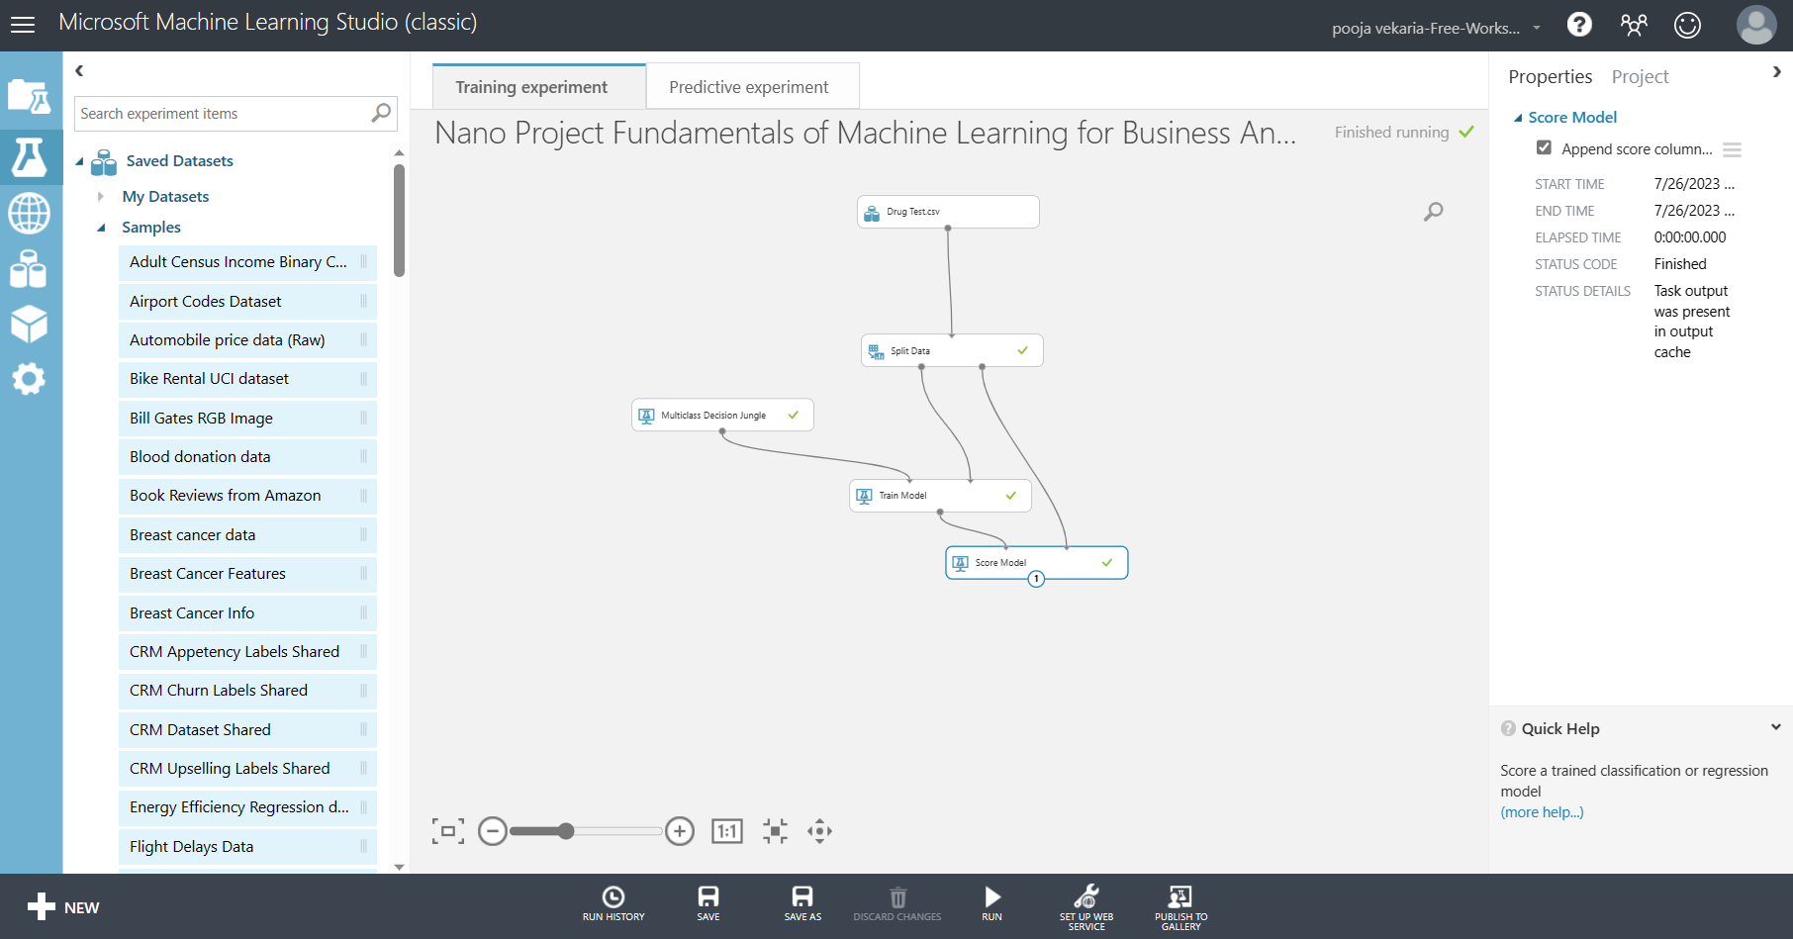
12. On the search bar search for score model and drag and drop the tile underneath the train model tile connect the score model tile to the train model tile and the split data model tile, ensure append score columns to output is ticked in properties and click run.

Slide 14
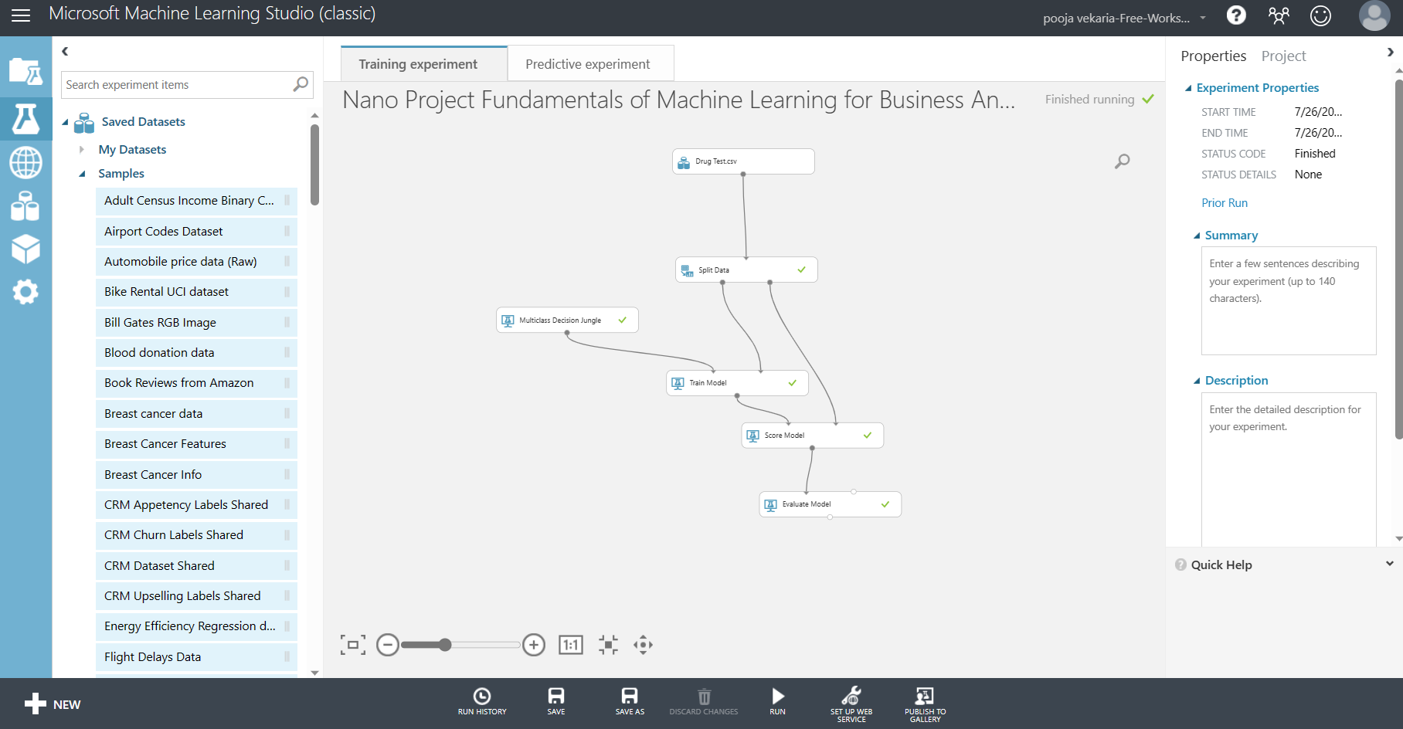
13. On the search bar search for evaluate model and drag drop the tile underneath the score model tile and connect the tiles and click run.

Slide 15

14. Once the model is completed, the next step is to create a predictive web service [recommended], by clicking on set up web service.

Slide 16
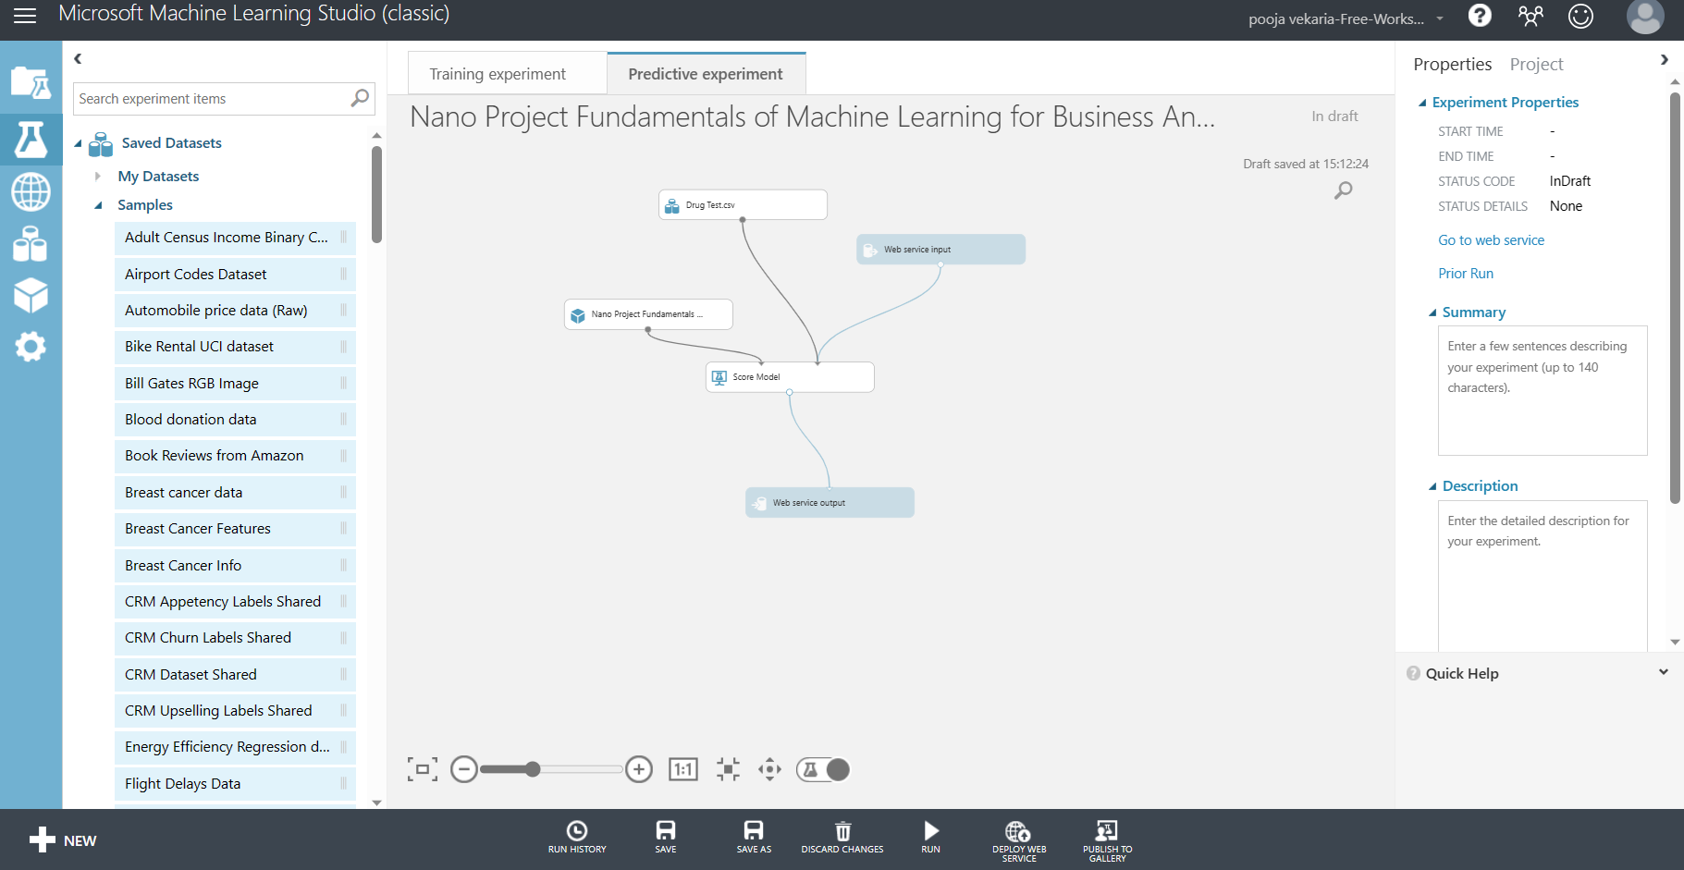
15. The predictive web service [recommended] will automatically generate a predictive experiment, it will automatically apply web service input/output which helps the model predict future drug groups.

Slide 17
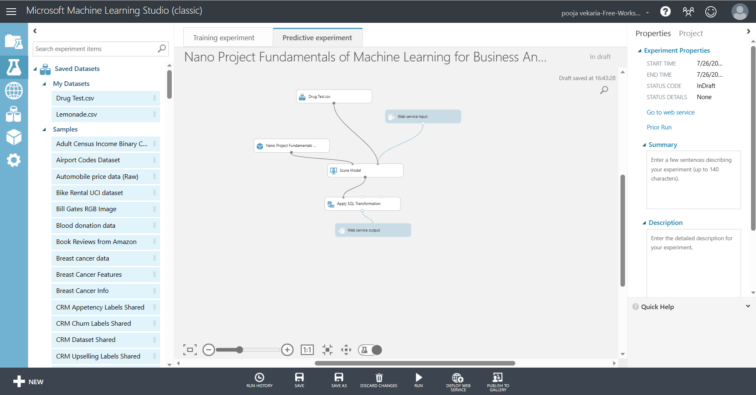
16. To the predictive experiment add apply SQL transformation, remove connection between web service output and score model and search for apply SQL transformation module and drop under, score model and connect, connect web service output module to output of apply SQL transformation.

Slide 18
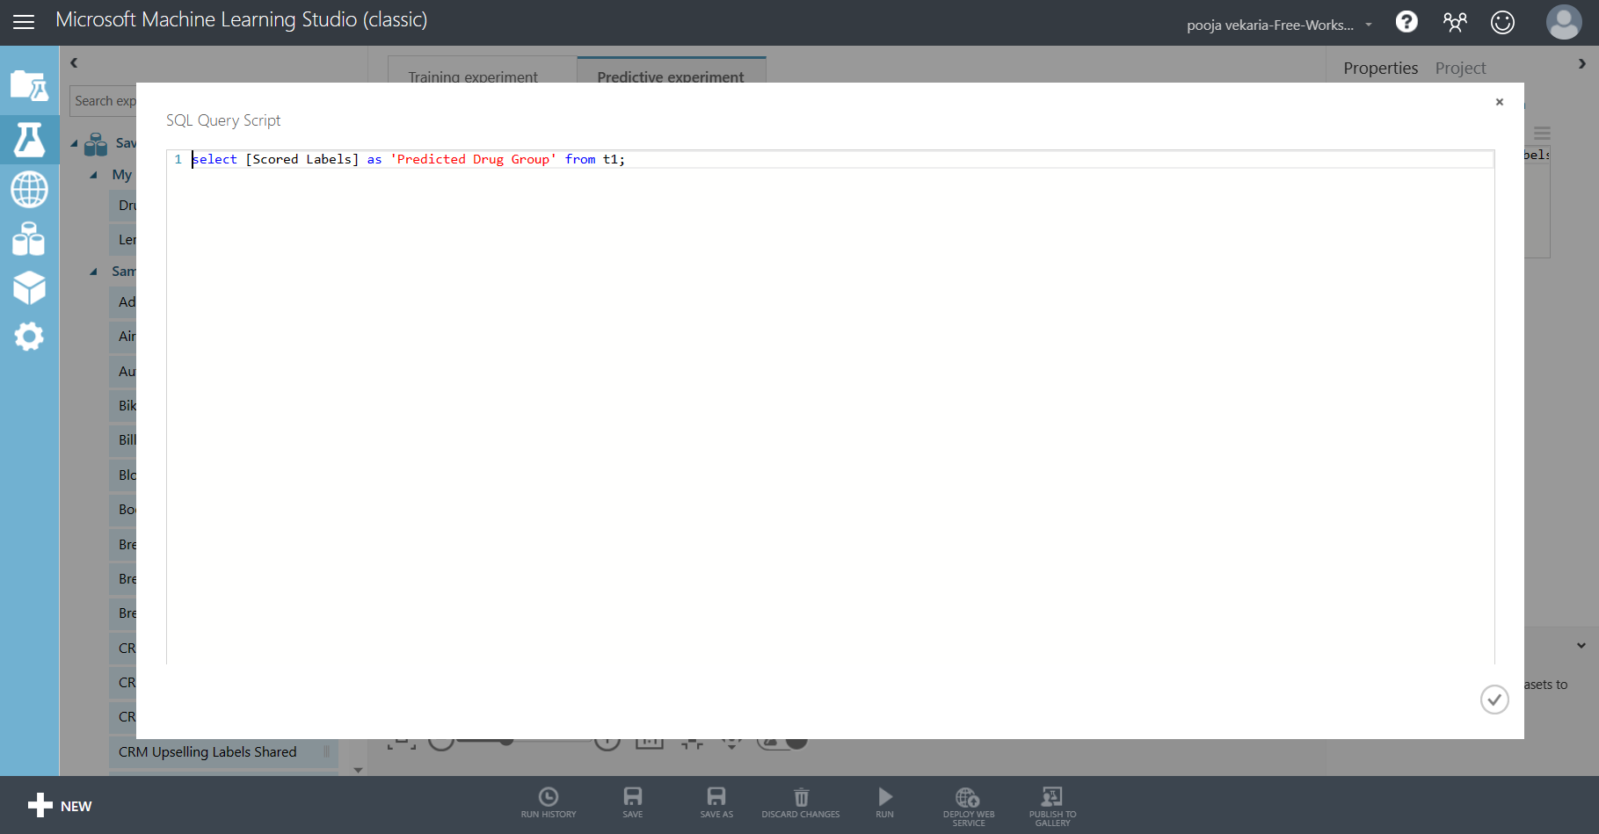
17. In the properties for apply SQL transformation apply the following, , so the scored labels can be relabelled by predicted drug group,

Slide 19

18. Click run to check the predictive experiment has no errors.

Slide 20
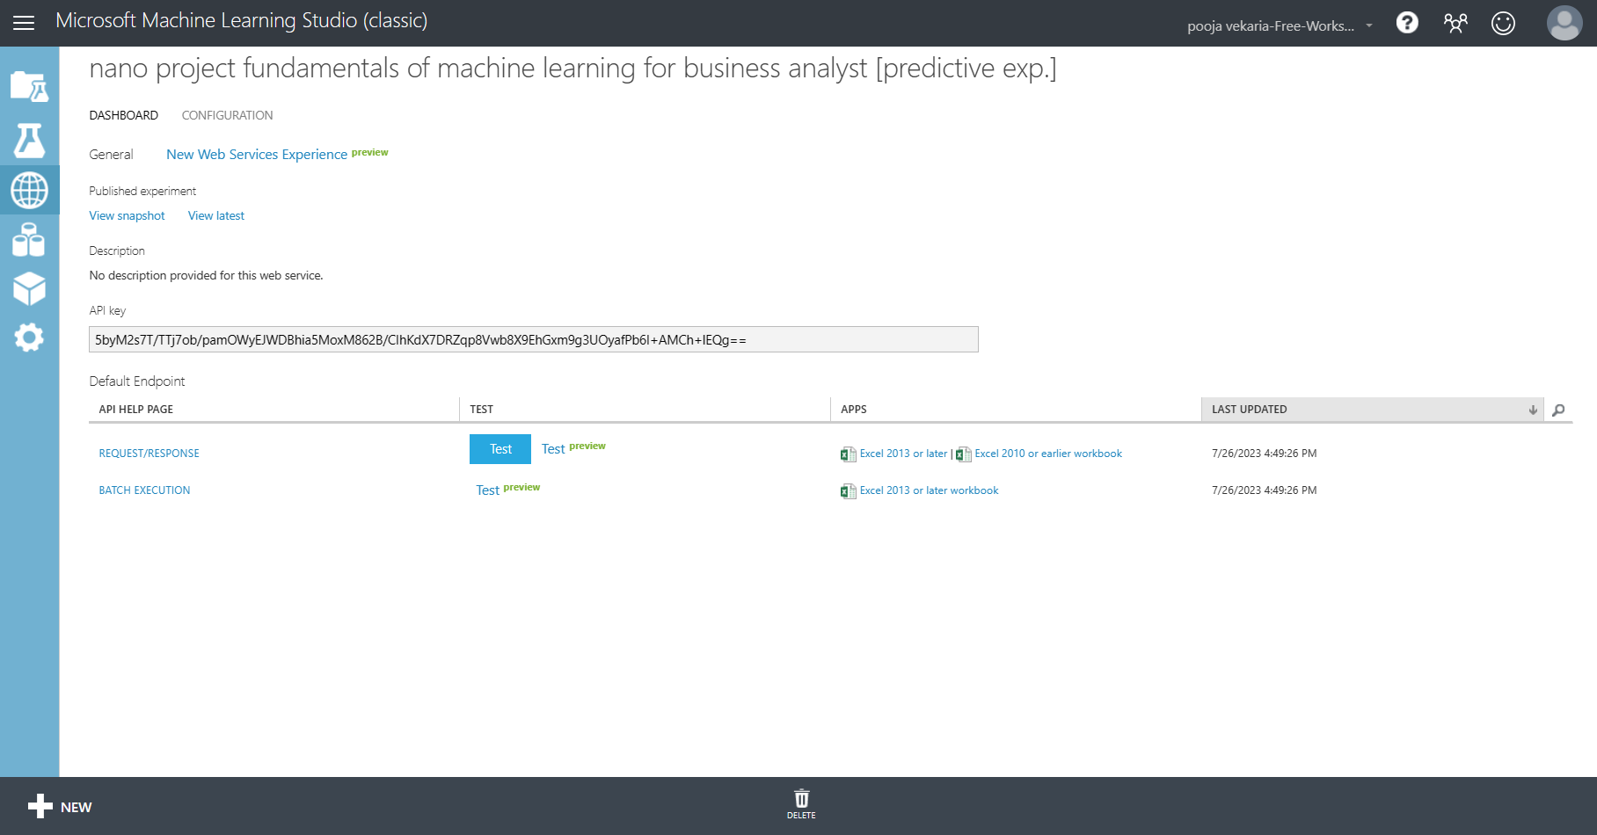
19. The next step will be to deploy web services to begin predicting the drug groups. Click on batch execution – excel 2013 or later workbook.

Slide 21
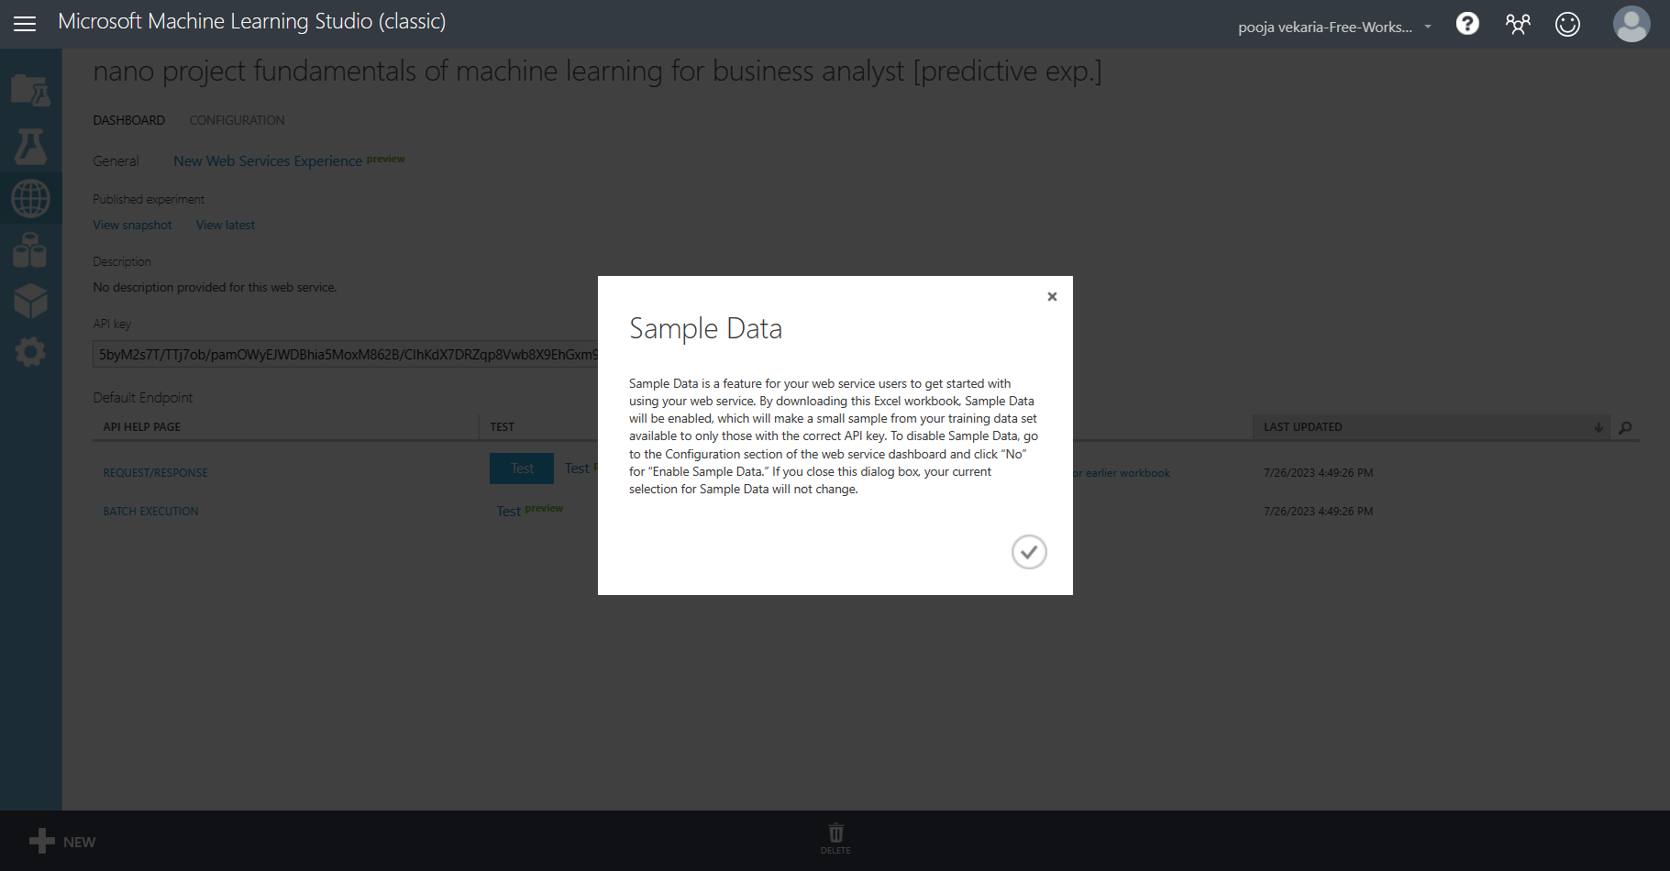
20. Click the tick button for the generation of an excel file.

Slide 22
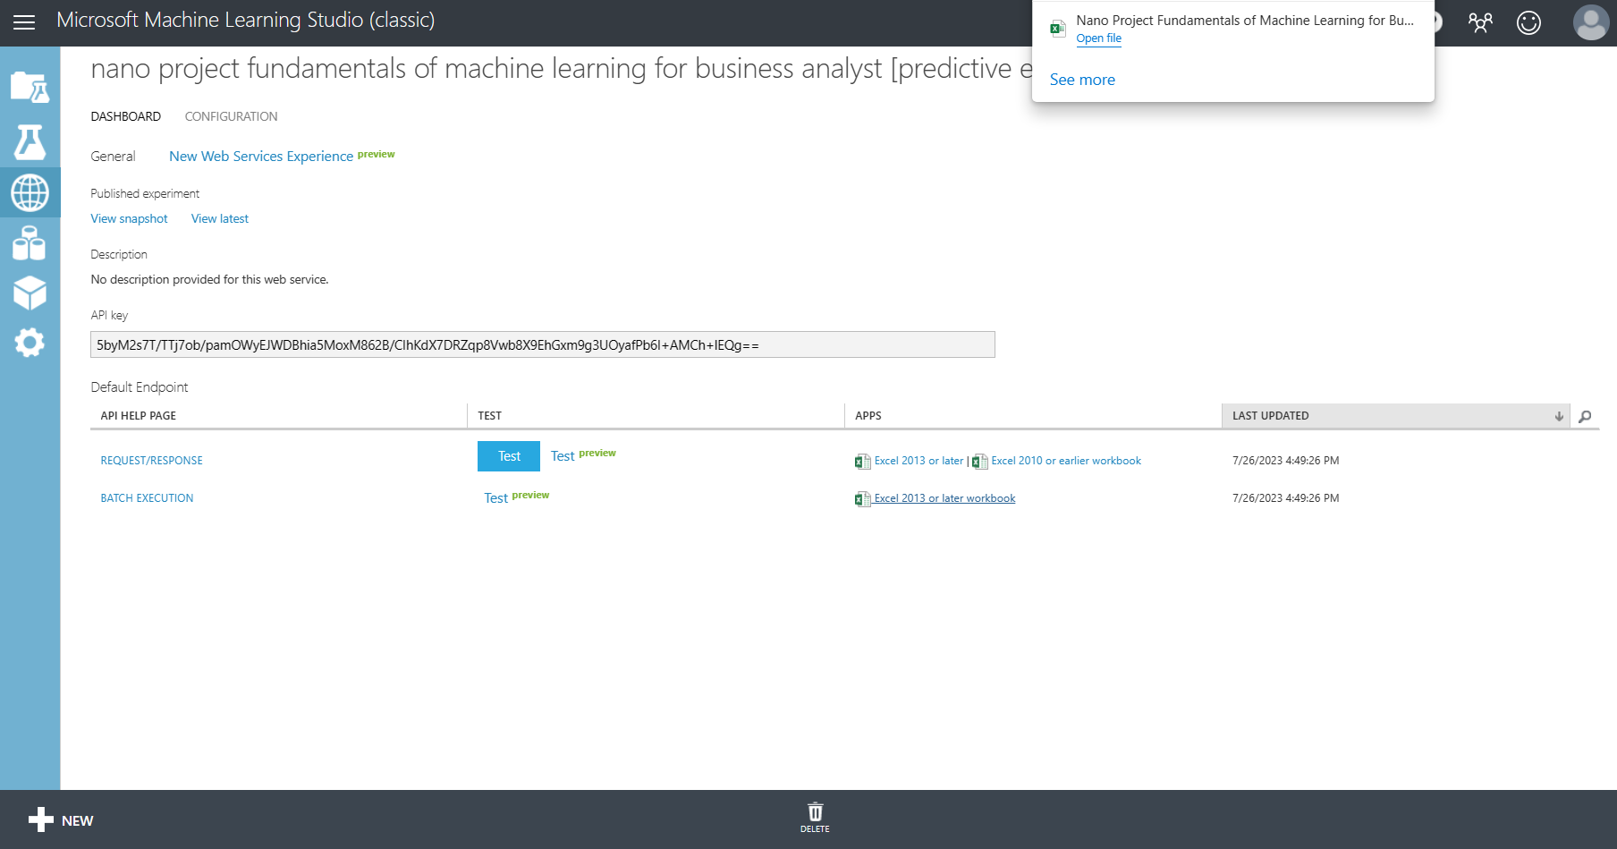
21. Click the tick button for the generation of an excel file. Once the file is created open file.

Slide 23
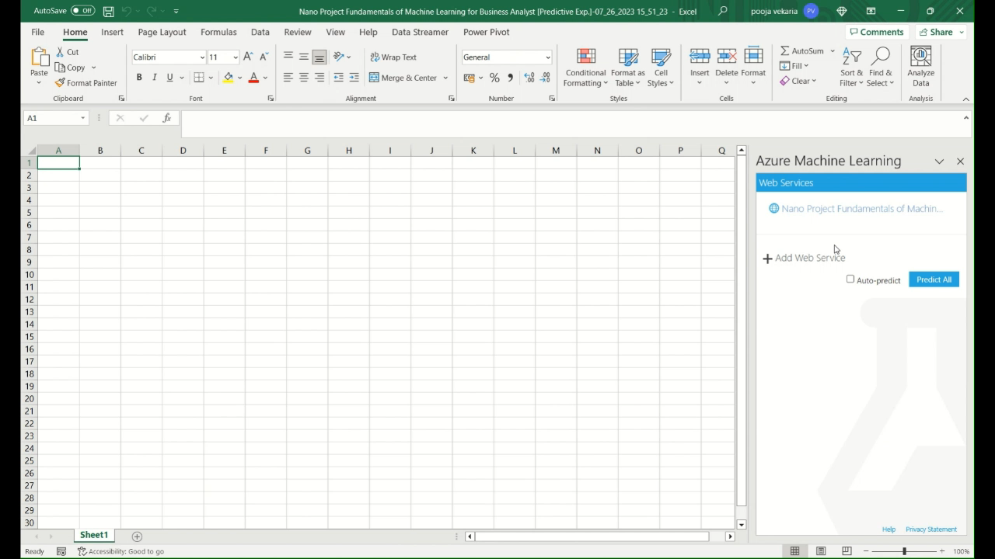
22. The following video shows when the sample data is generated the model will predict the drug group according to the sample data so if the values are changed (if the auto predict) function is used then the drug group is automatically calculated.

